Slide 1
Chapter 6 : AnOVA

Slide 2
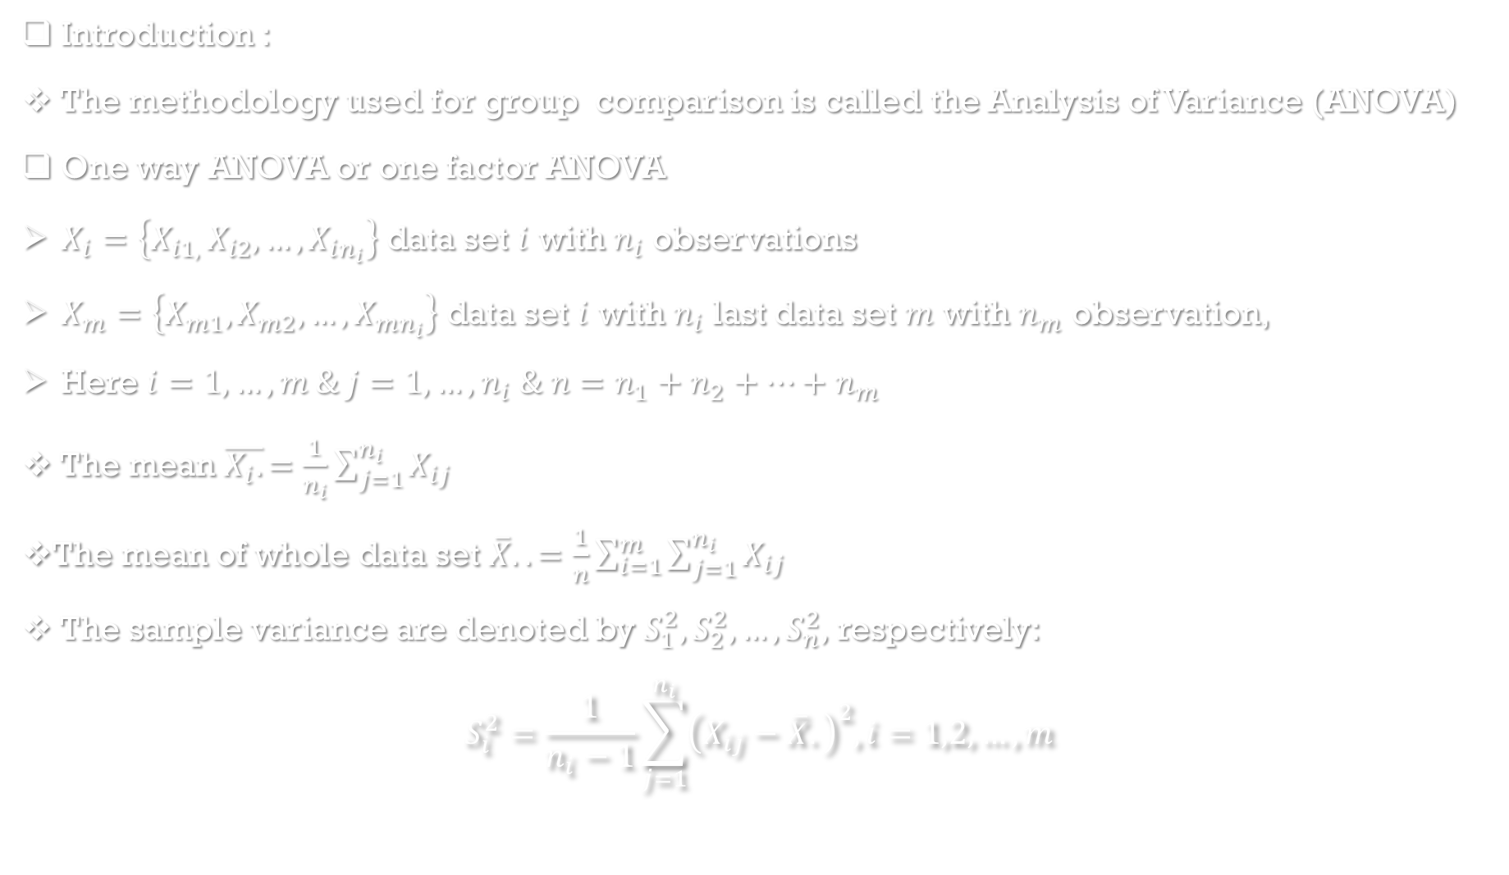
Introduction :
The methodology used for group comparison is called the Analysis of Variance (ANOVA)
One way ANOVA or one factor ANOVA
$X_{i}=\left\{X_{i1, }X_{i2},…, X_{in_{i}}\right\}$ data set $i$ with $n_{i}$ observations
$X_{m}=\left\{X_{m1}, X_{m2},…, X_{mn_{i}}\right\}$ data set $i$ with $n_{i}$ last data set $m$ with $n_{m}$ observation,
Here $i=1,…,m \& j=1,…,n_{i} \& n=n_{1}+n_{2}+…+n_{m}$
The mean $\overline{X_{i}.}=\frac{1}{n_{i}}\sum_{j=1}^{n_{i}}{X_{ij}}$
The mean of whole data set $\overline{X}..=\frac{1}{n}\sum_{i=1}^{m}{\sum_{j=1}^{n_{i}}{X_{ij}}}$
The sample variance are denoted by $S_{1}^{2},S_{2}^{2},…,S_{n}^{2},$ respectively:
$$S_{i}^{2}=\frac{1}{n_{i}−1}\sum_{j=1}^{n_{i}}{{\left(X_{ij}−\overline{X}.\right)}^{2}, i=1,2,…,m}$$

Slide 3
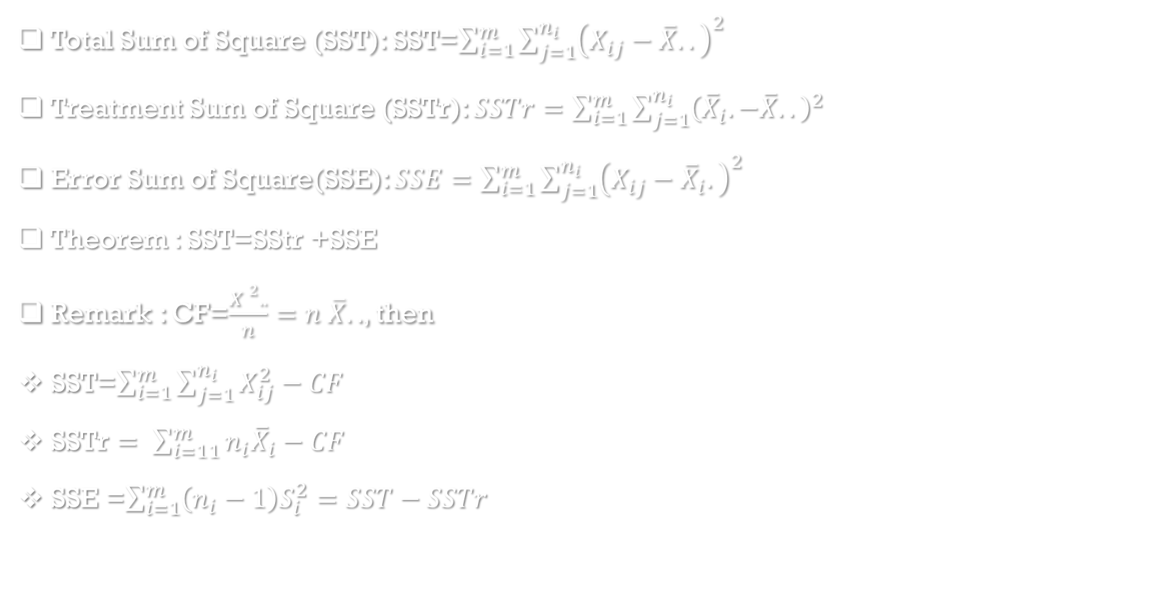
Total Sum of Square (SST): SST=$\sum_{i=1}^{m}{\sum_{j=1}^{n_{i}}{{\left(X_{ij}−\overline{X}..\right)}^{2} }}$
Treatment Sum of Square (SSTr): $SSTr=\sum_{i=1}^{m}{\sum_{j=1}^{n_{i}}{{\left({\overline{X}}_{i}.−\overline{X}..\right)}^{2} } }$
Error Sum of Square(SSE): $SSE=\sum_{i=1}^{m}{\sum_{j=1}^{n_{i}}{{\left(X_{ij}−{\overline{X}}_{i}.\right)}^{2}}}$
Theorem : SST=SStr +SSE
Remark : CF=$\frac{X ^{2}..}{n}=n \overline{X}..$, then
SST=$\sum_{i=1}^{m}{\sum_{j=1}^{n_{i}}{X_{ij}^{2}}−CF}$
SSTr $= \sum_{i=11}^{m}{n_{i}{\overline{X}}_{i}−CF}$
SSE =$\sum_{i=1}^{m}{\left(n_{i}−1\right)S_{i}^{2}=SST−SSTr}$

Slide 4
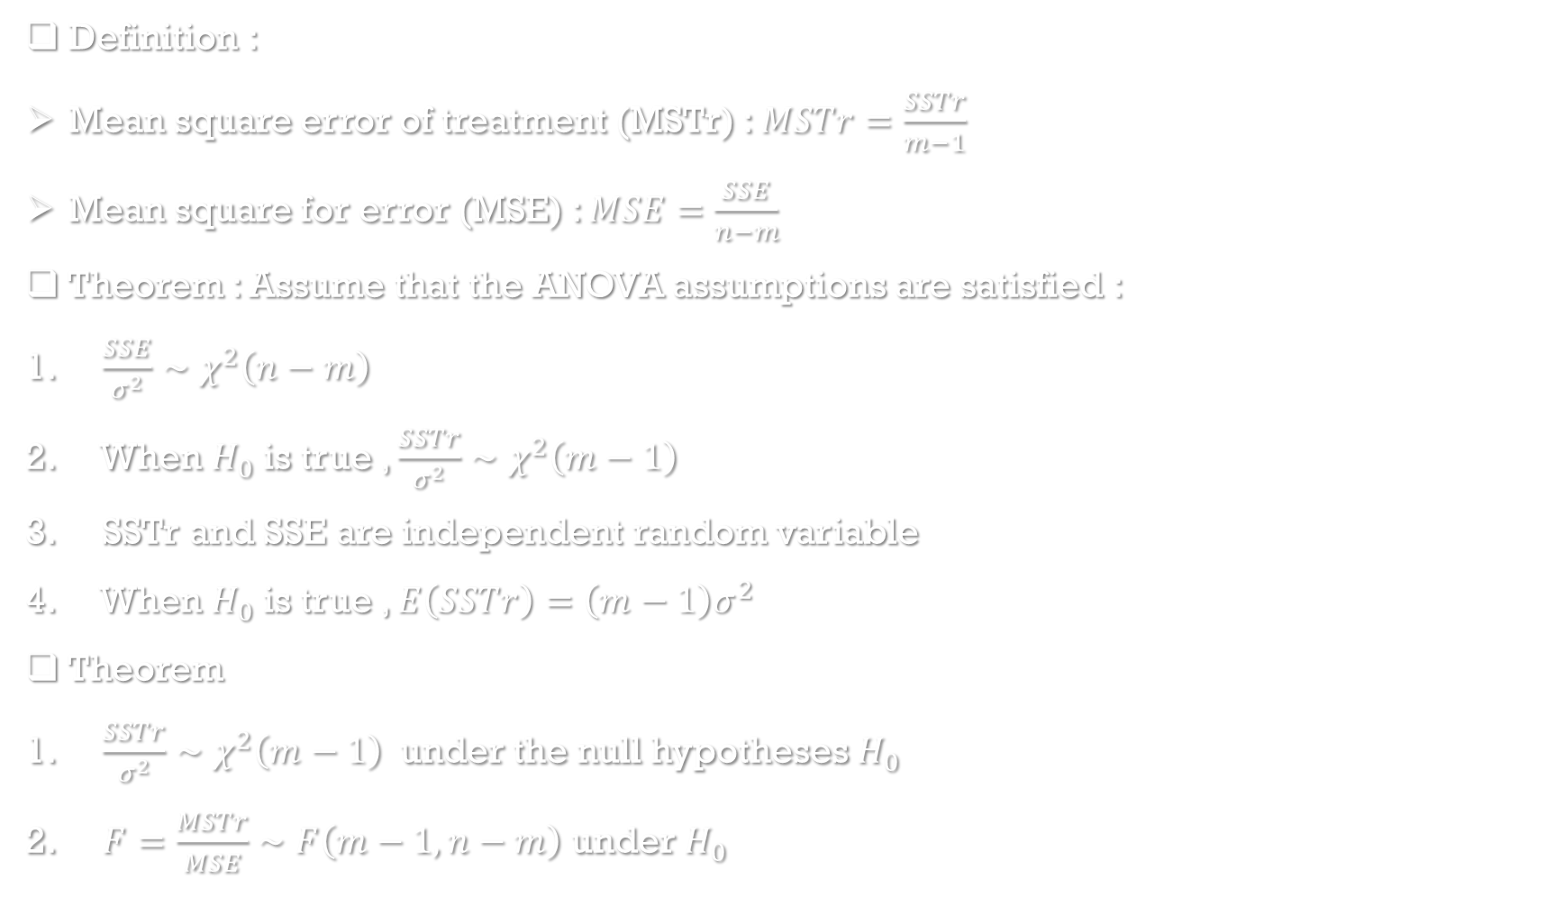
Definition :
Mean square error of treatment (MSTr) : $MSTr=\frac{SSTr}{m−1}$
Mean square for error (MSE) : $MSE=\frac{SSE}{n−m}$
Theorem : Assume that the ANOVA assumptions are satisfied :
$\frac{SSE}{σ^{2}}∼χ^{2}\left(n−m\right)$
When $H_{0}$ is true , $\frac{SSTr}{σ^{2}}∼χ^{2}\left(m−1\right)$
SSTr and SSE are independent random variable
When $H_{0}$ is true , $E\left(SSTr\right)=\left(m−1\right)σ^{2}$
Theorem
$\frac{SSTr}{σ^{2}}∼χ^{2}\left(m−1\right)$ under the null hypotheses $H_{0}$
$F=\frac{MSTr}{MSE}∼F\left(m−1,n−m\right)$ under $H_{0}$

Slide 5
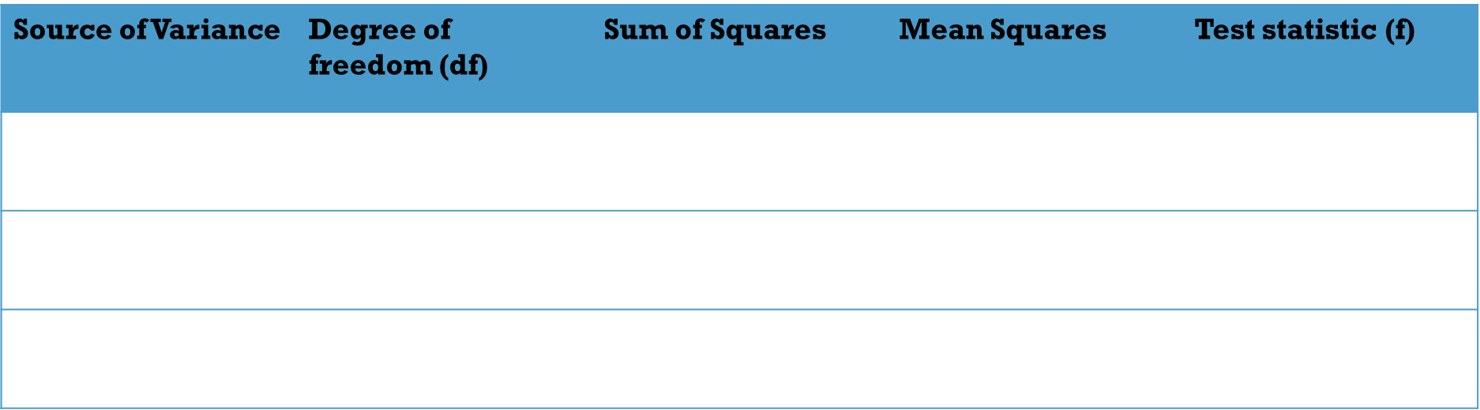

Theorem: Assume that the ANOVA assumption are satisfied. Then the statistic in single factr ANOVA if F=MSTr/MSE. When $H_{0}$ is true $F∼F\left(m−1,n−m\right)$, and the rejection region at the level of significance $α$ using the test statistic value f, is given by $RR=\left\{f:f≥F_{α,m−1,n−m}\right\}$
ANOVA Table
Source of Variance | Degree of freedom (df) | Sum of Squares | Mean Squares | Test statistic (f)
Treatments | $m−1$ | SSTr | MSTr=SSTr/m-1 | MSTr/MSE
Error | $$n−m$$ | SSE | MSE=SSE/n-m
Total | $$n−1$$ | SST

